Slide 1
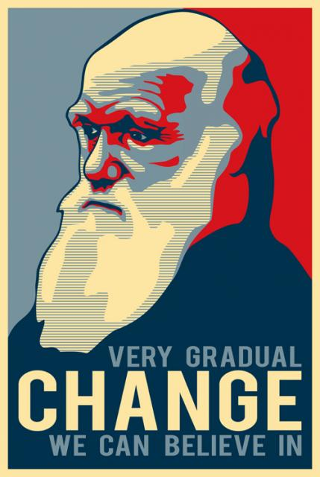
Darwin and natural selection
Notes:
Bell questions: What are acquired traits? Examples. What are inherited traits? Examples.

Slide 2
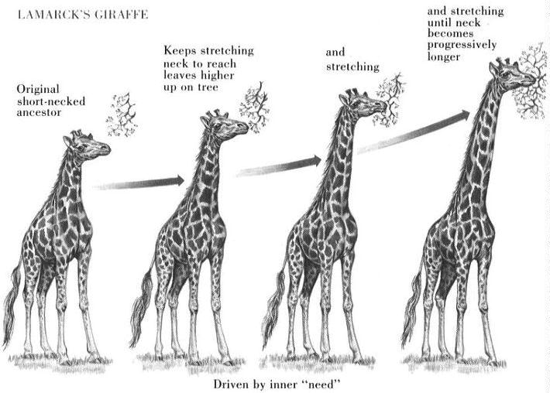
Before Darwin…
Jean-Baptiste Lamarck
Inheritance of acquired traits

Slide 4
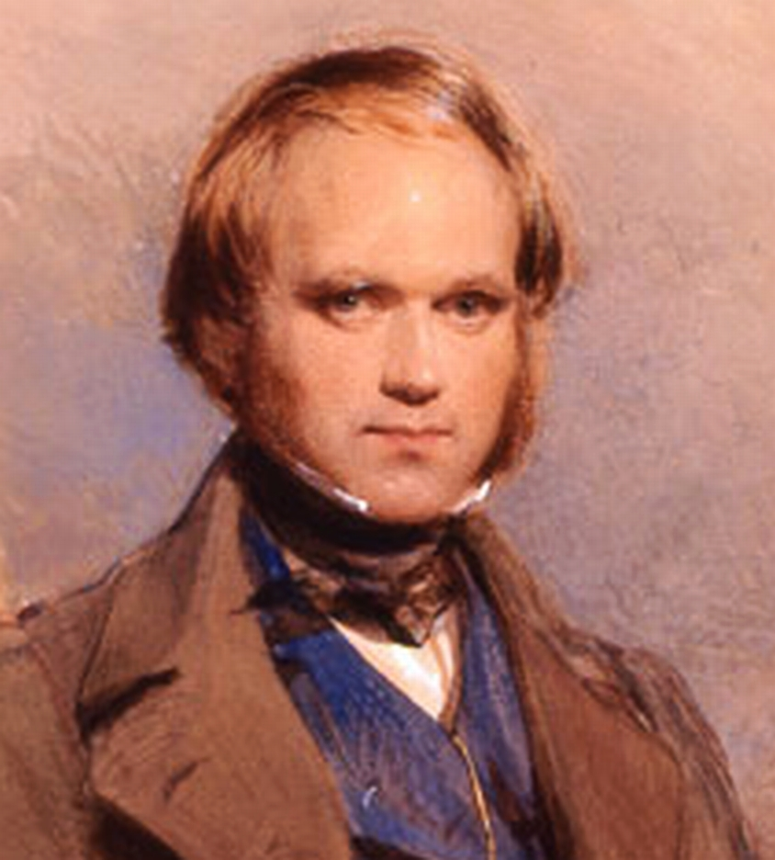
Charles darwin (1809 – 1882)
British naturalist
Proposed a method for how organisms develop adaptations that can lead to separate species
Natural Selection
“Survival of the fittest!”

Slide 5
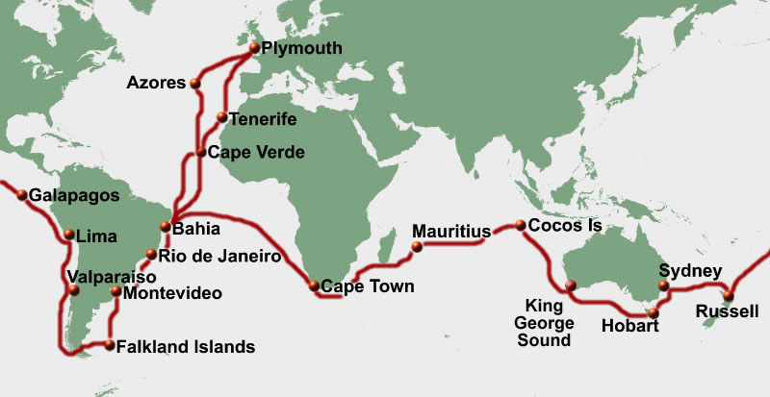
Voyage of the HMS Beagle (1831-1836)
Traveled around the world
Capt. Robert Fitzroy
Main mission to chart the South American coastline
Notes:
Darwin- took a 5 year voyage around the world on the HMS Beagle at the age of 22
Over the course of the trip Darwin collected a variety of natural specimens, including birds, plants, and fossils.
Galapagos islands were of particular interest to him. Why?
Other naturalists believed that all species either came into being at the start of the world, or were created over the course of natural history.

Slide 6
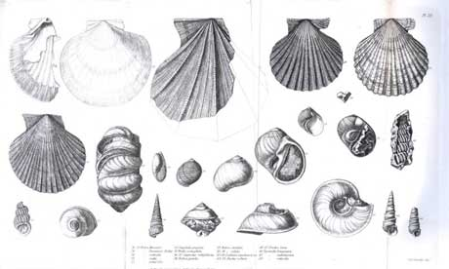
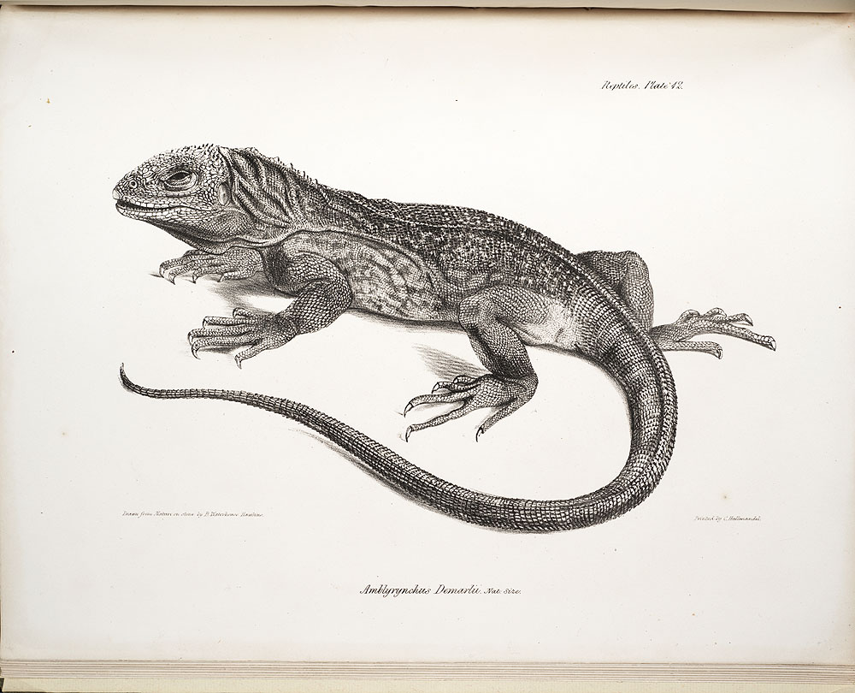
Voyage of the HMS Beagle (1831-1836)
Observed and recorded natural phenomena

Slide 7
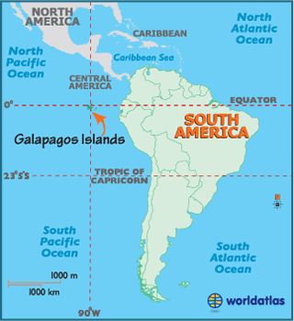
The galapagos islands
Recently formed volcanic islands
Most of the species on the Galapagos live nowhere else in the world
They look like species living on the mainland!

Slide 8
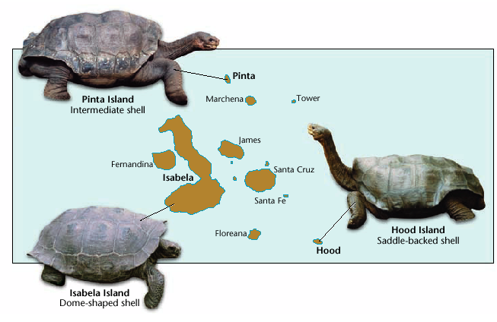
Giant tortoises
Is there a relationship between the environment and what an animal looks like?

Slide 9
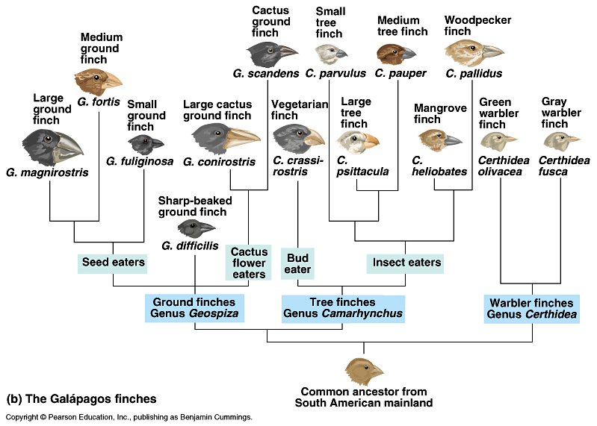
Beak shape & food type

Slide 10
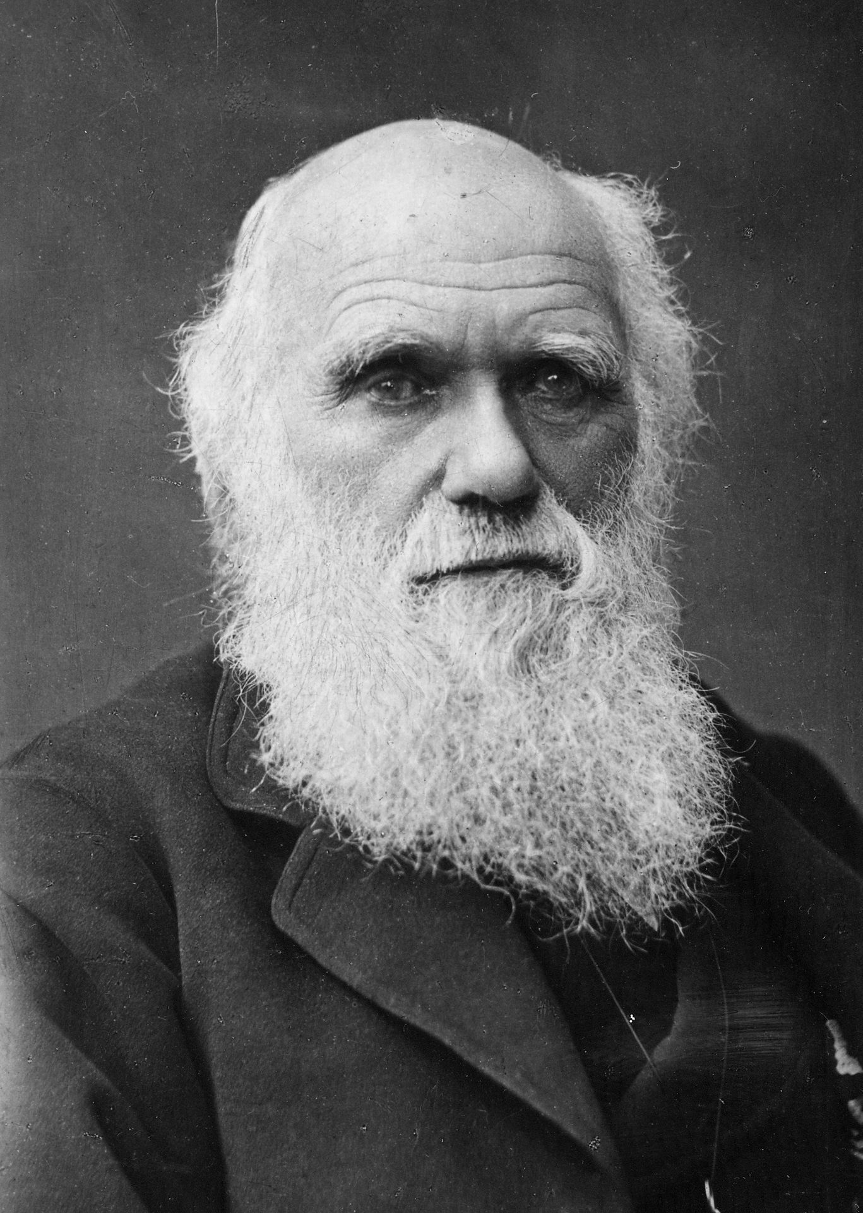
Natural selection is based on…
I concur!
Variation in the Population.
Survival of those suited to environment.
Some survive and reproduce while others don’t due to limited resources.

Slide 11
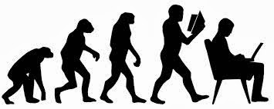
Natural selection predicts…
Individuals in each generation will differ slightly from members of each previous generation.
Over long periods of time, small differences accumulate to produce new species and eventually major transformations in the history of life.

Slide 12
Speciation
the formation of new and distinct species in the course of evolution.
FOSSIL RECORDS
Used to study evolution
EMBRYOLOGY
the study of embryos and their development

Slide 13
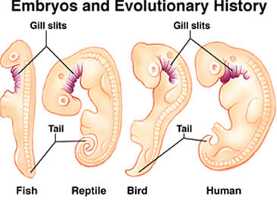

Slide 14
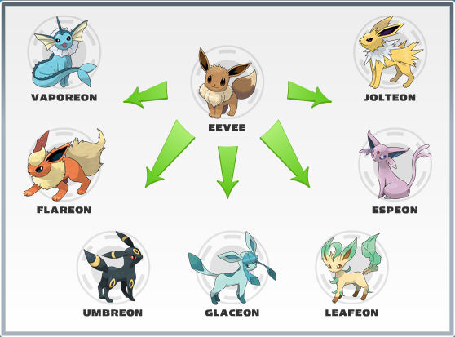
Divergent evolution

Slide 15
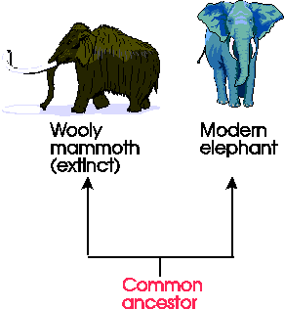
Divergent evolution
Similar organisms evolve from a common ancestor

Slide 16
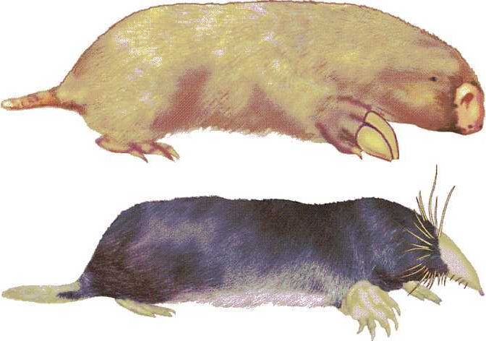
Did these two species evolve from a common ancestor?

Slide 17
Convergent evolution
Large front paws
Small eyes
Tapered nose
Large front paws
Small eyes
Tapered nose
Different ancestor

Slide 18
Convergent evolution
Organisms from different evolutionary lineages may evolve analogous adaptations to similar environments.

Slide 19
Types of Selection

Slide 20
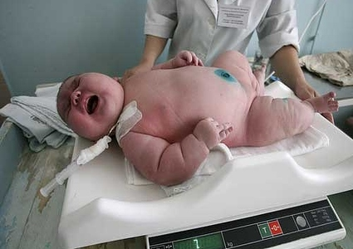
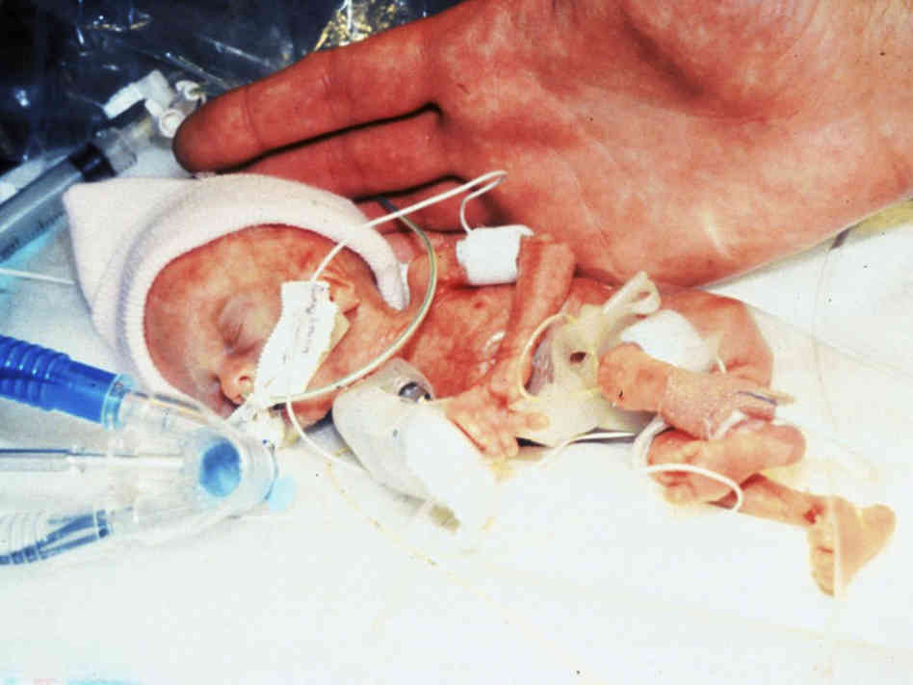
Stabilizing selection

Slide 21
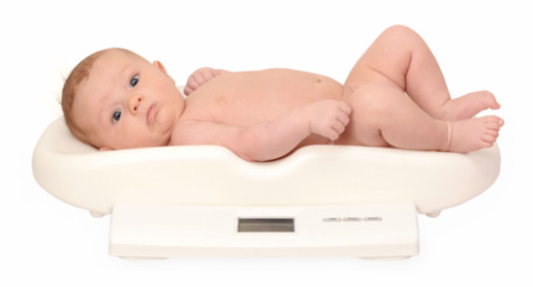
Stabilizing selection

Slide 22
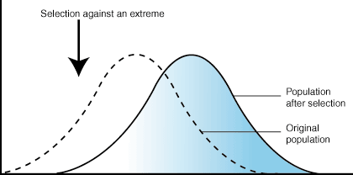
Directional selection

Slide 24
Disruptive selection

Slide 25
Disruptive selection
Extreme traits are favored
Population divided into two distinct groups

Slide 26
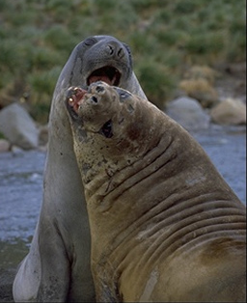
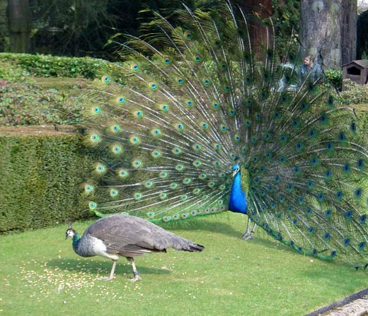
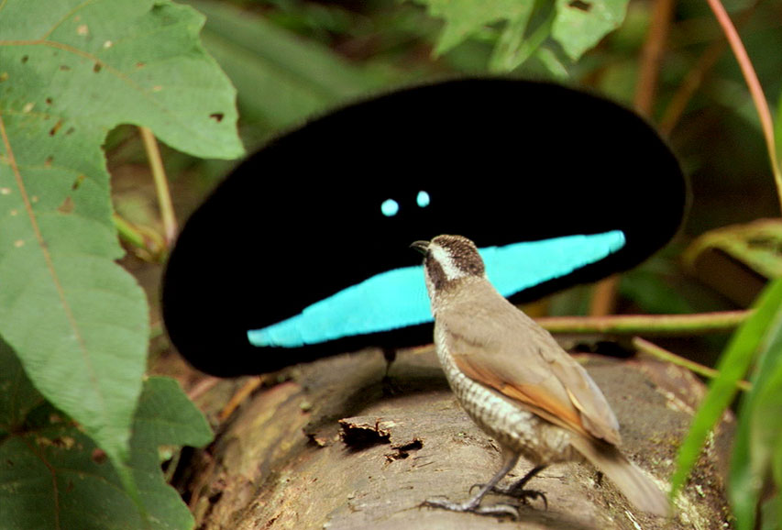
Sexual selection
Superb bird of paradise mating dance video

Slide 27
Sexual selection
Acts on organism’s ability to obtain or successfully reproduce with a mate.
Often powerful enough to produce features that are harmful to survival (i.e. attract predators)
Can lead to extreme differences in male/female phenotypes!

Slide 28
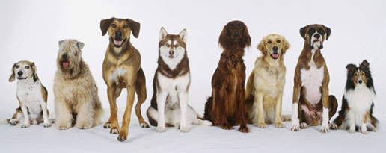
Artificial Selection

Slide 29
?

Slide 31
Teosinte → modern Maize corn
Wild grass from Mexico and Central America
Can pollinate cultivated corn to produce viable seeds
What selective pressure did humans put on teosinte to develop modern corn?
Notes:
Gradual Changes over time - Types and amounts of starch production
Ability to grow in different climates and types of soil
Length and number of kernel rows
Kernel size, shape, and color
Resistance to pests

Slide 32
Teosinte → modern Maize corn
Notes:
Not only have the Kernels changed but the plant itself has evolved over time as well.

Slide 33
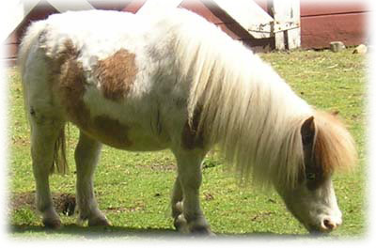
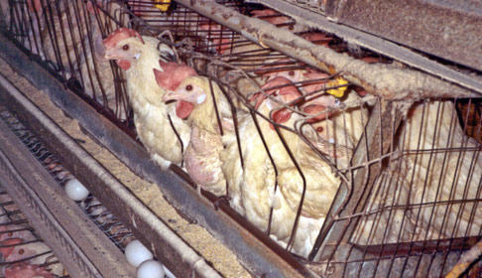
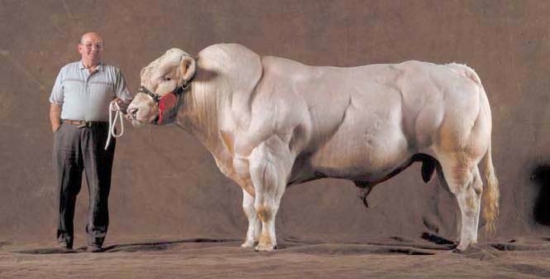
What about animals?
Notes:
Belgian Blue- Double muscling (which happens due to a mutation), have adapted to their environment, don’t do well in extremely cold climates because their skin is thin and they don’t deposit much fat.
Shetland Pony – used to pull carts

Slide 34
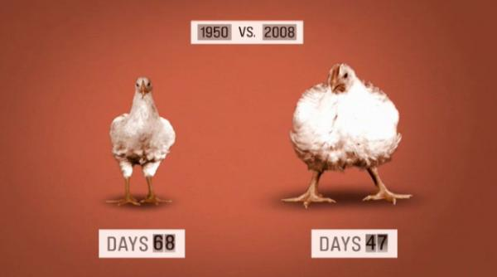
Notes:
Due to selective/artificial breeding

Slide 35
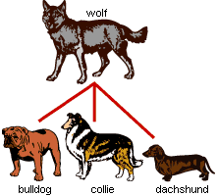
Dog breeding
Wolf → dog ancestor → modern breeds
Selected traits for hunting, companionship

Slide 36
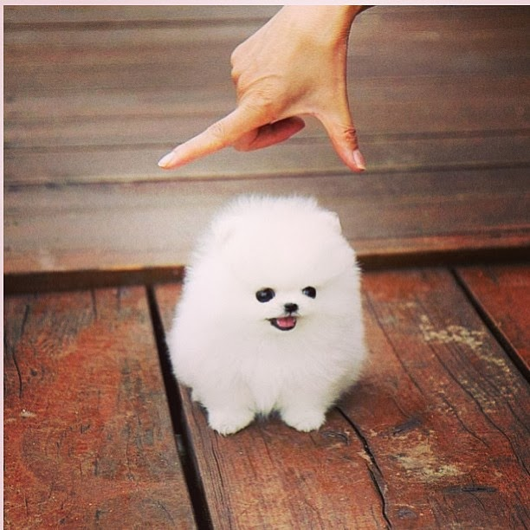
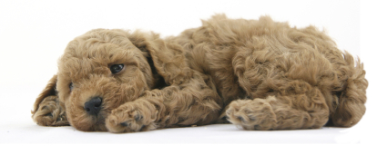
Designer dogs?

Slide 37
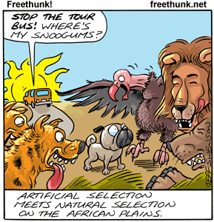
Questions?

Slide 38
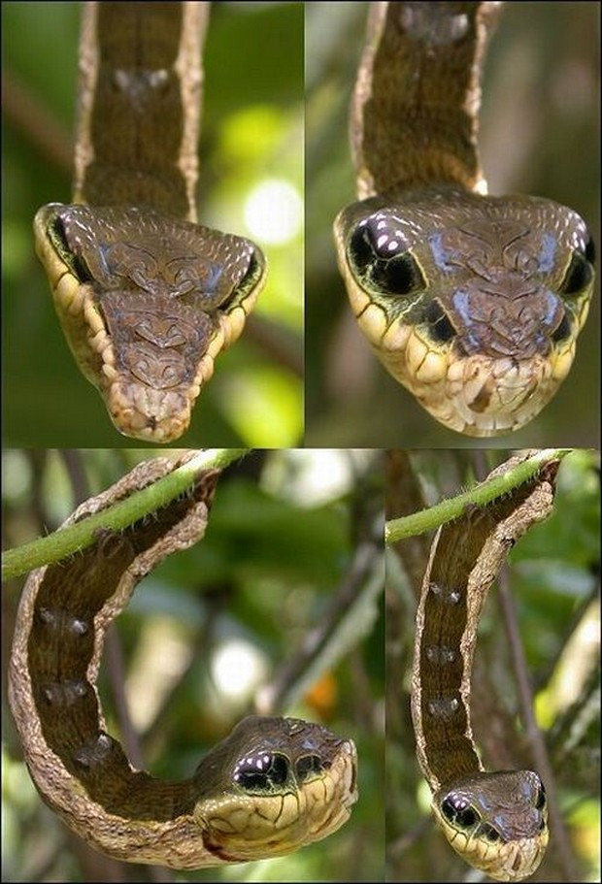
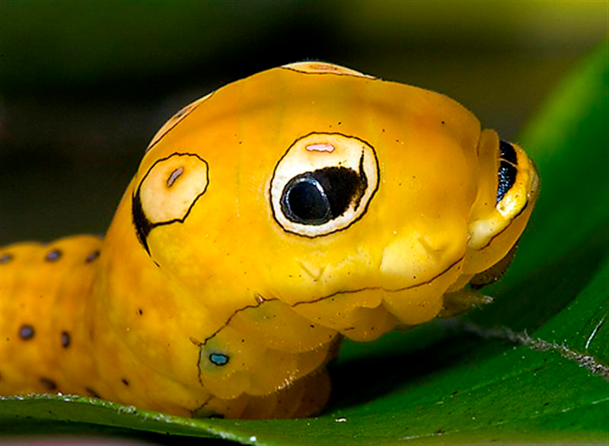
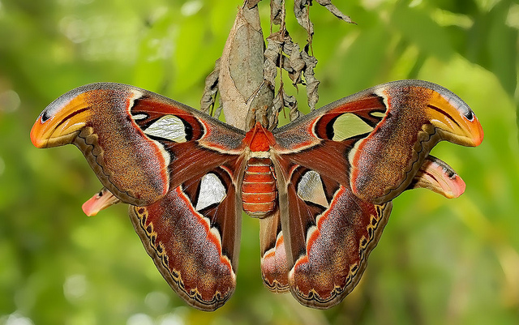
Structural Adaptation
Mimicry: When an organism mimics another organism to survive. Example: Moth Caterpillar defends itself by looking like a snake.

Slide 39
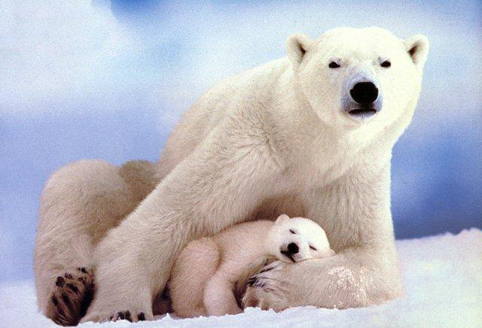
Behavioral Adaptations
Type of behavior that is learned over time.
Example: Caribou migration, Polar bear “hibernation”

Slide 40
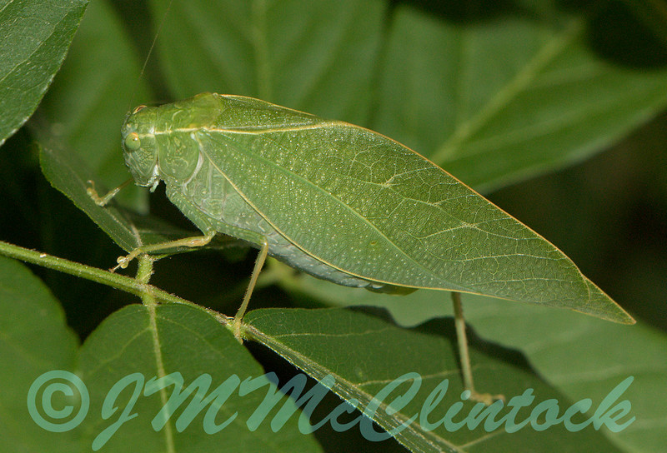
Structural Adaptation
Camouflage: Blending into something. Example: Leaf bug blends into leaf.

Slide 41
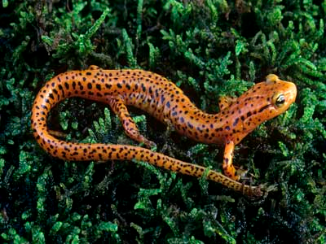
Anatomy
Homologous Structures: The same physical structure, but different functions. Example: Salamander arm, Turtle arm, human arm.

Slide 42
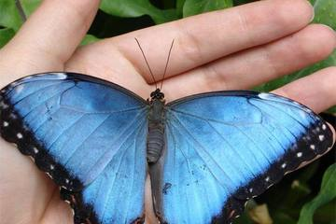
Anatomy
Analogous Structures: Different physical structure, same function. Example: Bird wing, butterfly wing.

Slide 43
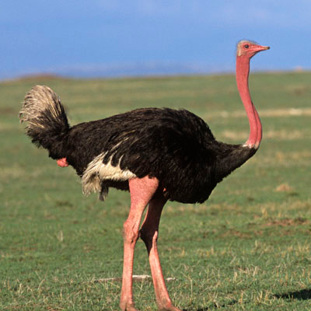
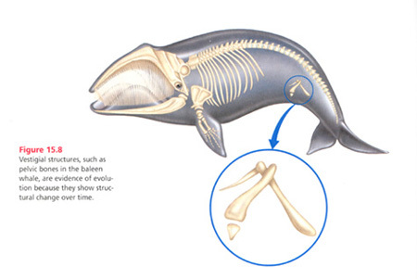
Anatomy
Vestigial Structures: Structures that are no longer necessary. Example: Ostrich wings, whale femur bone

Slide 44
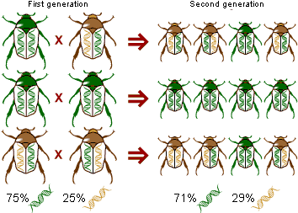
Genetic Drift
Random fluctuation in gene frequency which can cause one allele to become common in a population at the expense of the alternative allele.

Slide 45
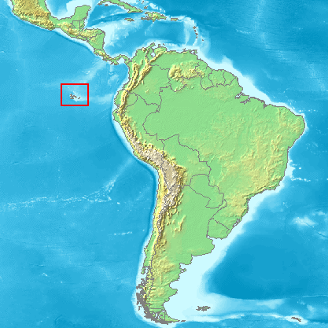
Geographic Isolation
A geographic boundary that separates a population. (Iguanas & turtles on the Galapagos Islands)

Slide 46
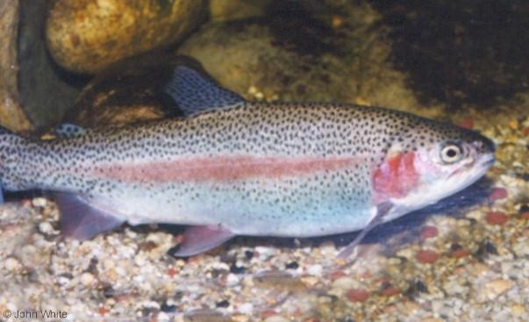
Reproductive Isolation
Members of a population are reproductively isolated from the normal population. (Trout: Rainbow trout spawn in the spring. Brook trout spawn in the fall.)

Slide 47
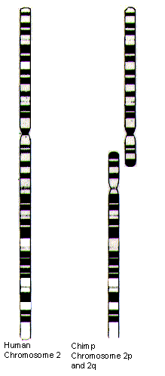
Chromosomal Fusion
Two chromosomes fusing together.
All great apes apart from man have 24 pairs of chromosomes. There is therefore a hypothesis that the common ancestor of all great apes had 24 pairs of chromosomes and that the fusion of two of the ancestor's chromosomes created chromosome 2 in humans. The evidence for this hypothesis is very strong.

Slide 48
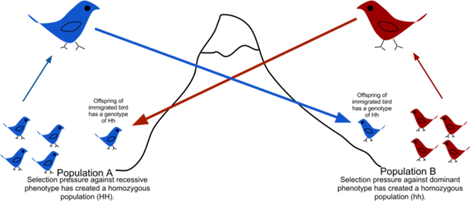
Gene flow
The transfer of alleles or genes from one population to another. Migration into or out of a population may be responsible for a marked change in allele frequencies

